Slide 1
Financial Analysis of
Wright State University
Howard Bunsis
Professor of Accounting, Eastern Michigan University
February 1, 2018

Slide 2
Roadmap
Overall financial condition of WSU: A significant decline
Timing of proposed cuts – these negotiations have no effect on the ability to stay off of Fiscal Watch
Administration Response for staying off Fiscal Watch and how current changes already meet the SB 6 benchmark
Reasons for the declining performance: Examination of tuition revenue, enrollment, state SSI, WSU Administration legal issues and administrative spending, Athletics
Faculty Salaries Under the Administration Proposal
Health Care Analysis: Faculty out of pocket costs

Slide 3
1.
Overall Financial Condition of Wright State University:
A Significant Decline

Slide 4
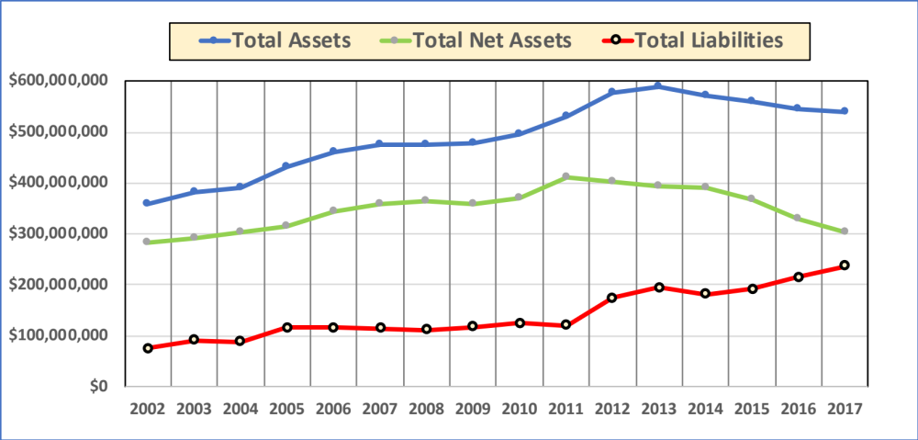
Wright State Balance Sheet
Source: Audited Financial Statements, Adjusted for GASB 68 (Pensions)

Slide 5
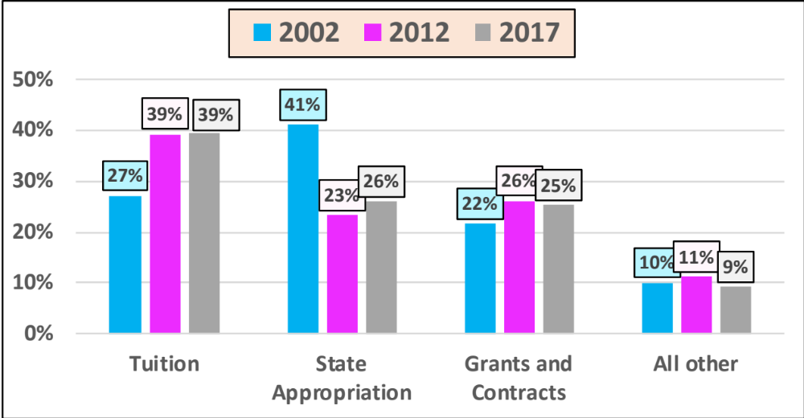
Wright State Revenue Distribution Over Time
Source: Audited Financial Statements

Slide 6
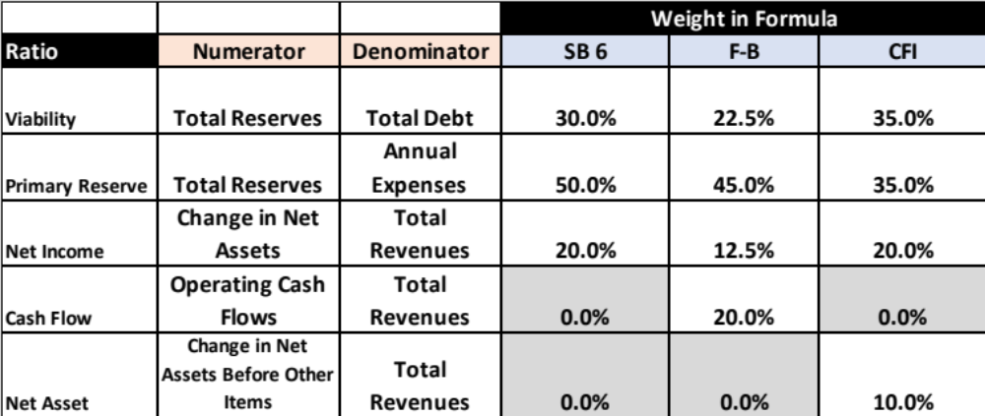
Ratios to Define University Performance

Slide 7
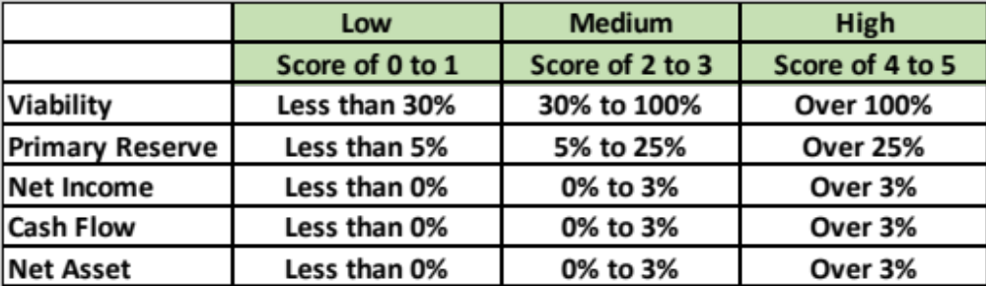
Ratio Scores

Slide 8
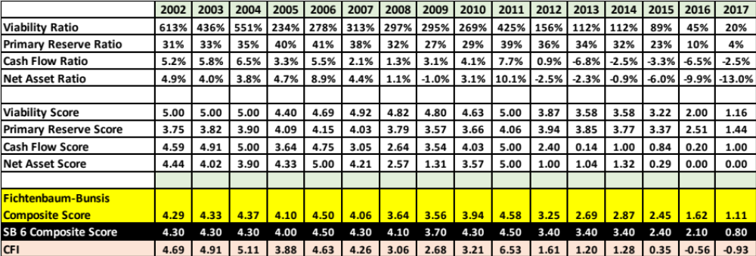
Ratio Data for Wright State Over time

Slide 9
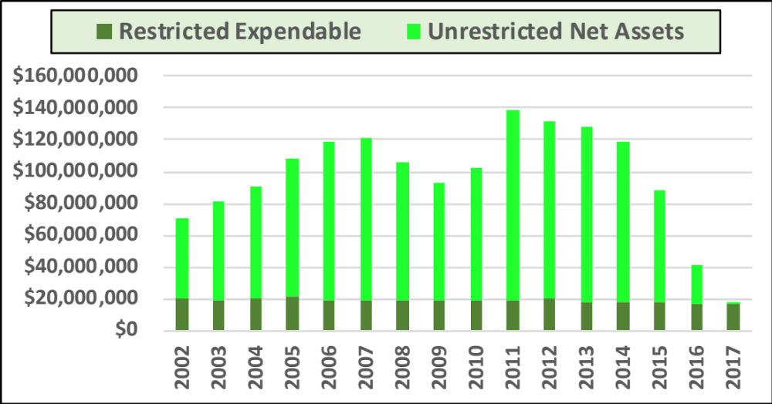
Total Reserves Over Time

Slide 10
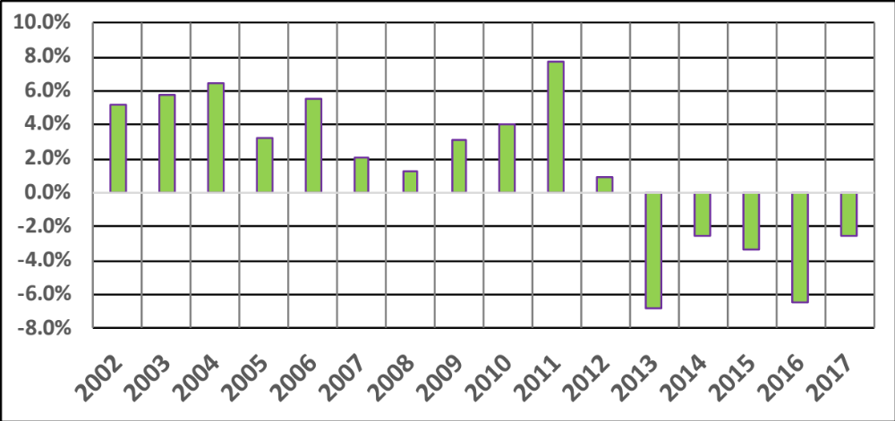
Cash Flow Ratio Over Time

Slide 11
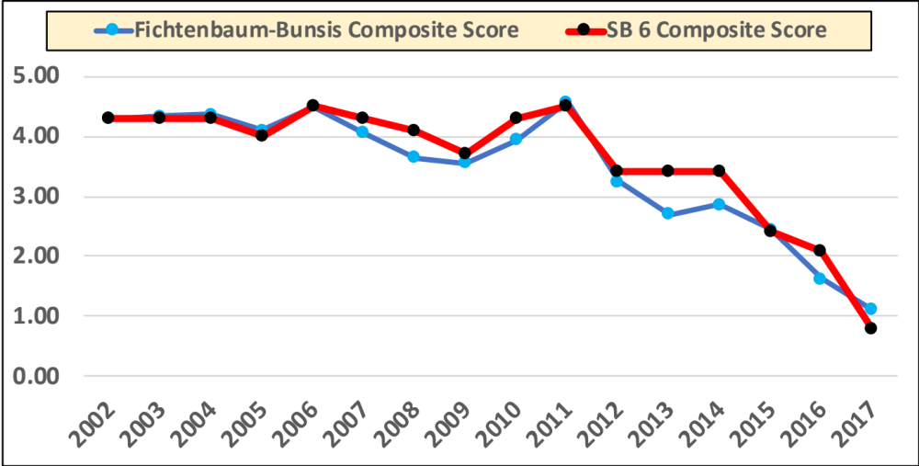
Composite Ratio Scores Graphically Over Time

Slide 12
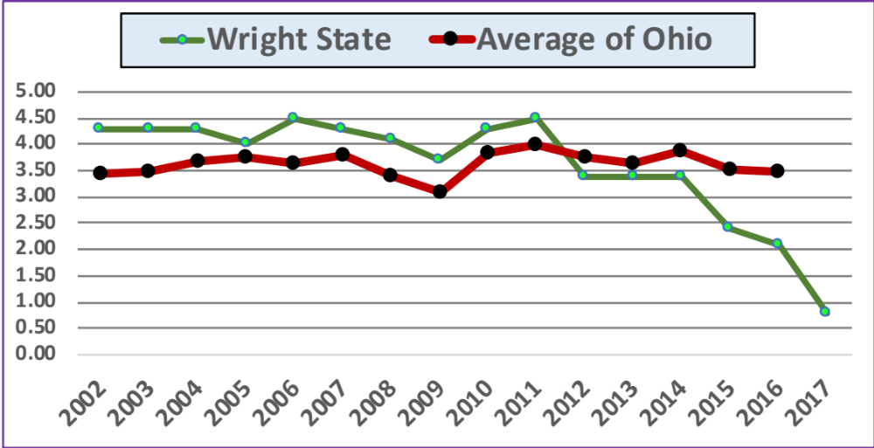
WSU SB 6 Score Compared to Other Ohio Publics
Source: https://www.ohiohighered.org/campus-accountability

Slide 13
Wright State Bond Rating
Moody's Downgrades Wright State University to Baa2 from A2; Outlook Negative: May 2, 2017
The downgrade is driven by WSU's severe financial deterioration in a short period of time, with significant operating deficits in FY 2016 and projected for FY 2017 resulting in substantial reduction in liquidity.
Management is implementing a comprehensive expense reduction plan to restore fiscal balance in FY 2018.
However, with a relatively inflexible expense base, realizing adequate savings to align with revenues will prove challenging. Should the university not accomplish its expense realignment plan, it will continue to have deficit operations and potential further draw downs on liquidity, which could trigger additional downward rating pressure.
The Baa2 favorably incorporates WSU's regionally important role as a low-cost public university serving the Dayton region, with good scale, solid fundraising, diverse revenue, and a predictable debt structure.
It also incorporates the university's relationship with the State of Ohio (Aa1 stable), which has implemented enhanced monitoring of the university's financial condition.

Slide 14
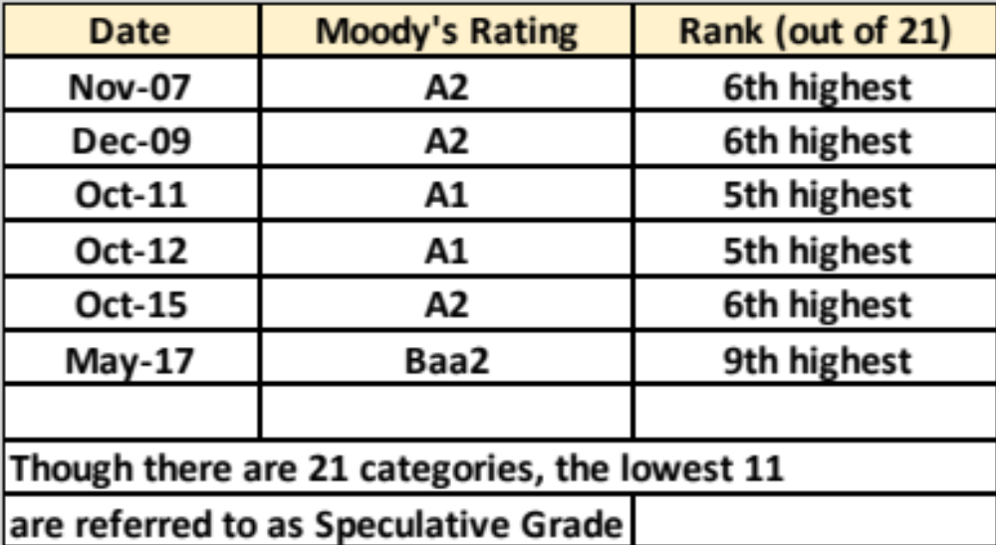
Wright State Moody’s Ratings Over Time

Slide 15
2.
These Negotiations Will Not Affect The 2018 SB6 Score and Fiscal Watch

Slide 16
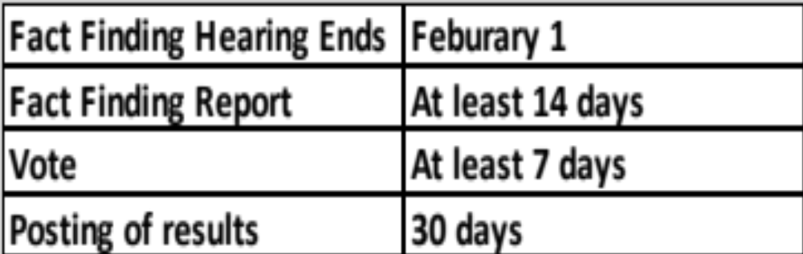
Fiscal Watch Timing and Fact-Finding
Source: http://www.serb.state.oh.us/pdf/FF-Guidebook-2014.pdf
In order to stay off of fiscal watch, the SB 6 composite ratio score must be 1.90 for FISCAL 2018, which ends on June 30, 2018

Slide 17
Issues in Practice
Assuming no delays or unusual issues, the fact-finding process will end towards the end of March
Even if the draconian health care changes are implemented, the most time these could affect fiscal 2018 is for one month of the academic year
Bargaining unit salaries for 2017-2018 are already set – at 0%
Any changes being negotiated in this process will not fully take effect until the fall of 2018, well after the fiscal year ends on June 30, 2018
Bottom line: These negotiations will not affect WSU’s ability or inability to reach the SB 6 benchmark that avoids fiscal watch

Slide 18
3.
Administration Plan to Prevent Fiscal Watch:
Simulation Proves the Proposed Administrative Cuts are Too Deep

Slide 19
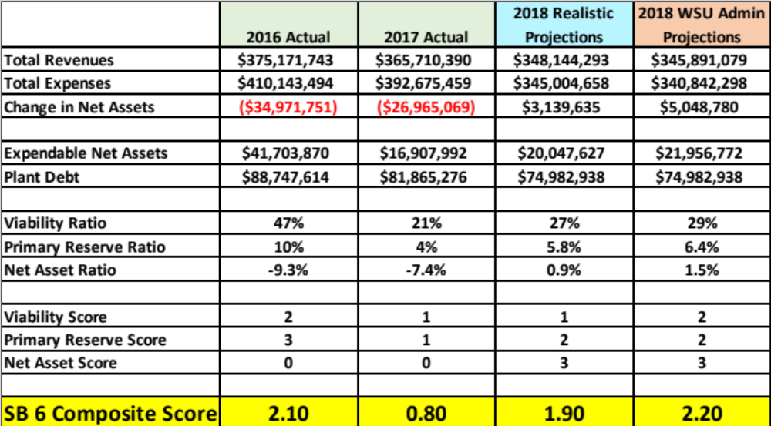
SB 6 Simulation: Raw Data to Compute SB 6 Ratios
Source: https://www.wright.edu/sites/www.wright.edu/files/uploads/2017/Nov/meeting/FAI2_FY17%20Financial%20Presentation.pdf

Slide 20
Revenue Forecasts Behind the Simulation
Source: https://www.wright.edu/sites/www.wright.edu/files/uploads/2018/Jan/meeting/FAI8_WSU%20Budget%20Variance%20Report%20-%20December%202017.pdf
Budgeted Tuition & Fees | 2017 Actual | Budget Reforcast FY18 | $$ Change | % Change
Gross Tuition & Fees (December) | $187,954,000 | $172,007,000 | ($15,947,000) | -8.5%
Gross Tuition & Fees (earlier forecast) | $187,954,000 | $173,707,000 | ($14,247,000) | -7.6%
Step 1: Use WSU Budget to determine gross tuition revenue change:
Budgeted Revenue | 2017 Actual | Budget Reforcast FY18 | $$ Change | % Change
Tuition (Gross) | $187,954,000 | $172,007,000 | ($15,947,000) | -8.5%
Other Revenue | $117,993,000 | $113,850,000 | ($4,143,000) | -3.5%
Total Revenue | $305,947,000 | $285,857,000 | ($20,090,000) | -6.6%
Step 2: Use WSU Budget to determine other revenue change per budget:
 | 2017 Actual | 2018 Realistic Projection | $$ Change | % Change
Net Tuition | $140,388,956 | $128,455,895 | ($11,933,061) | -8.5%
Scholarships | $47,349,000 | $43,324,335 | ($4,024,665) | -8.5%
Gross Tuition | $187,737,956 | $171,780,230 | ($15,957,726) | -8.5%
Other Revenue | $225,321,434 | $219,688,398 | ($5,633,036) | -2.5%
Total Revenue | $365,710,390 | $348,144,293 | ($17,566,097) | -4.8%
Step 3: Convert Budget to Actual Financial Statement Basis (How SB 6 ratios are determined): Use 2.5% Decline for other revenue instead of -3.5%

Slide 21
Why -2.5% Is More Realistic than -3.5% for Other Revenue
The most important reason is what is forecast to happen with SSI in 2018:
  SSI is the 2nd largest revenue source, at 26% of total revenue
  Per the Ohio Board of Higher Education, SSI for Wright State in 2018 is forecast to decline only 0.5%
When the administration forecast total revenue in their budget documents, they are only forecasting 84% of the total actual revenues, and it is actual revenues that are used for SB 6
The administration is forecasting the following declines in large revenue items:
  20% decline in gifts, contributions and other revenues
  17% decline in grants and contracts
  3% decline in sales and service
For these reasons, a predicted 2.5% is much more realistic, and even this decline is very conservative

Slide 22
Final Revenue Projections
Realistic | 2017 Actual | 2018 Projection | $$ Change | % Change
Net Tuition | $140,388,956 | $128,455,895 | ($11,933,061) | -8.5%
Scholarships | $47,349,000 | $43,324,335 | ($4,024,665) | -8.5%
Gross Tuition | $187,737,956 | $171,780,230 | ($15,957,726) | -8.5%
Other Revenue | $225,321,434 | $219,688,398 | ($5,633,036) | -2.5%
Total Revenue | $365,710,390 | $348,144,293 | ($17,566,097) | -4.8%
WSU Administrtion | 2017 Actual | 2018 Projection | $$ Change | % Change
Net Tuition | $140,388,956 | $128,455,895 | ($11,933,061) | -8.5%
Scholarships | $47,349,000 | $43,324,335 | ($4,024,665) | -8.5%
Gross Tuition | $187,737,956 | $171,780,230 | ($15,957,726) | -8.5%
Other Revenue | $225,321,434 | $217,435,184 | ($7,886,250) | -3.5%
Total Revenue | $365,710,390 | $345,891,079 | ($19,819,311) | -5.4%
Difference |  |  | $$ Change
Net Tuition |  |  | $0
Scholarships |  |  | $0
Gross Tuition |  |  | $0
Other Revenue |  |  | $2,253,214
Total Revenue |  |  | $2,253,214

Slide 23
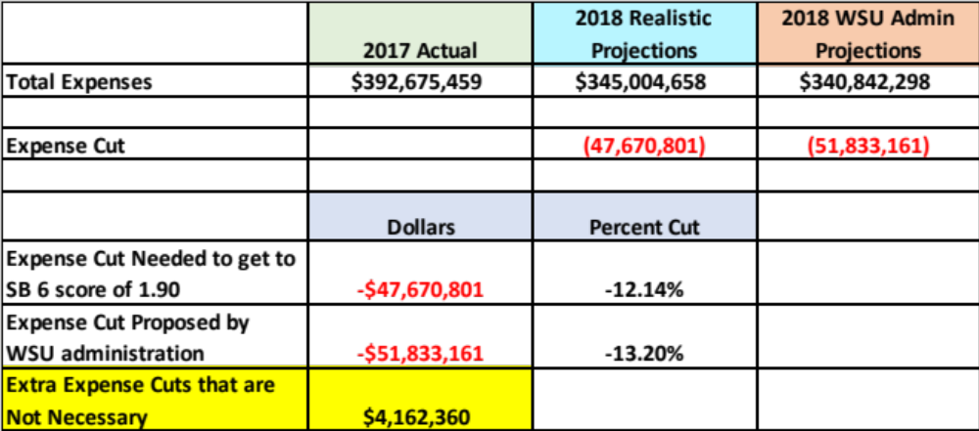
Expense Projections

Slide 24
Summary of SB 6 Simulation
Using budgeted and actual projections, a total revenue decline of 4.8% is more realistic than a 5.4% decline. This will lead to a lower revenue decline by $2.2 million
In order to arrive at an SB 6 composite score of 1.90, given the revenue decline above, an expense reduction of only $47.7 million is needed. The WSU administration believes that a $51.8 million reduction is necessary
A steep but realistic revenue decline of 4.8% combined with an expense decline of $51.8 million will lead to an SB 6 composite score of 2.20, which is well above the 1.90 needed.
However, an expense decline of only $47.7 million will still allow WSU to avoid fiscal watch.
Therefore, the WSU administration is proposing unnecessary cuts of $4.1 million ($51.8 million less $47.7 million). This difference alone is enough to negate the need for the health care increases being proposed

Slide 25
4.
Reasons for the declining performance:
How Did We Get Here?

Slide 26
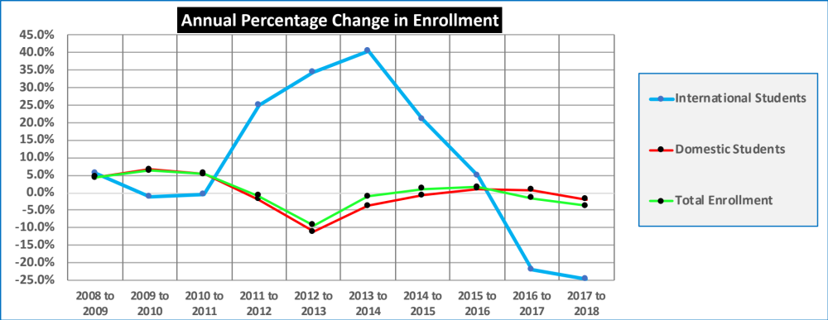
Enrollment: Is There Really an Enrollment Crisis?
2018 = Fall 2017
Source: https://www.ohiohighered.org/sites/ohiohighered.org/files/uploads/data/statistical-profiles/ph_rpt_2017_master_0.pdf

Slide 27
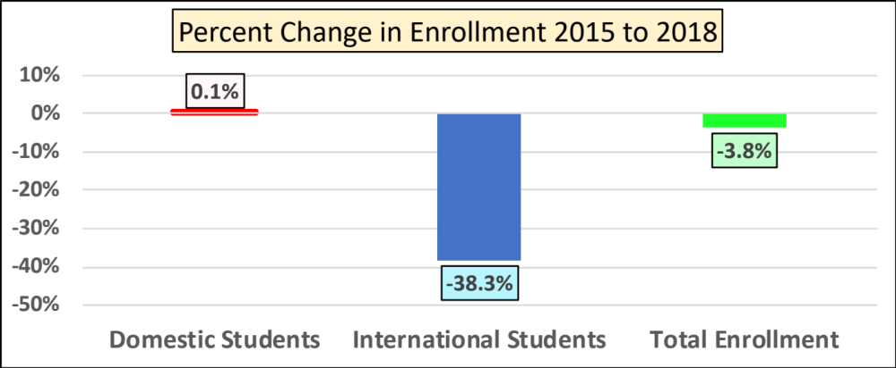
Change in WSU Enrollment from 2015 to 2018
98% of the total international student decline between 2016 and 2017 was due to declines in Kuwaiti, Saudi, and Indian student enrollment
Source: WSU BOT presentation, April 7, 2017

Slide 28
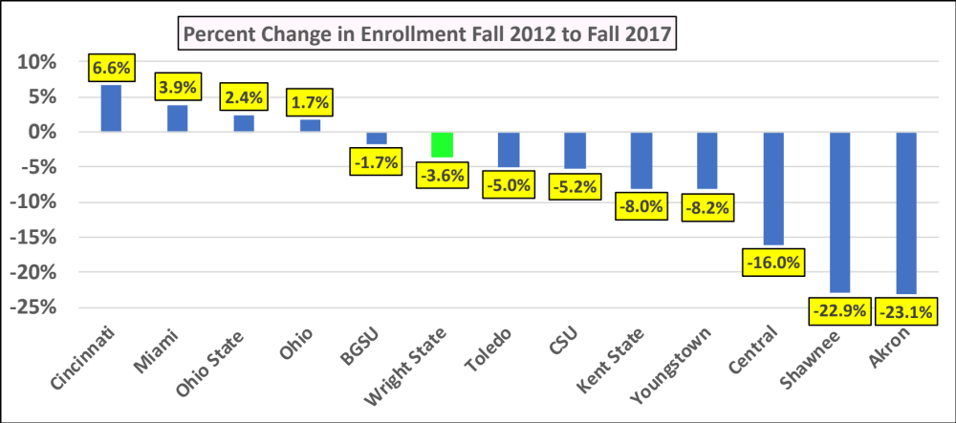
Change in WSU Enrollment vs. Other Ohio Public Institutions
Source: https://www.ohiohighered.org/sites/ohiohighered.org/files/uploads/data/statistical-profiles/ph_rpt_2017_master_0.pdf
Peer Average: -6.3%
7 institutions had declines larger than WSU

Slide 29
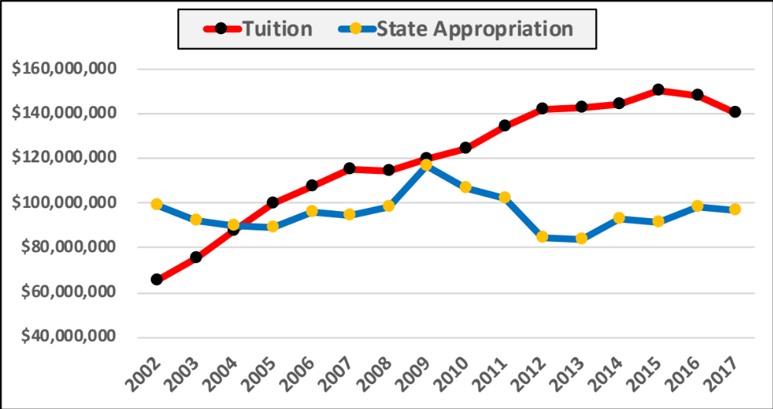
Tuition Revenue vs. the State Appropriation
Source: WSU Audited financial statements

Slide 30
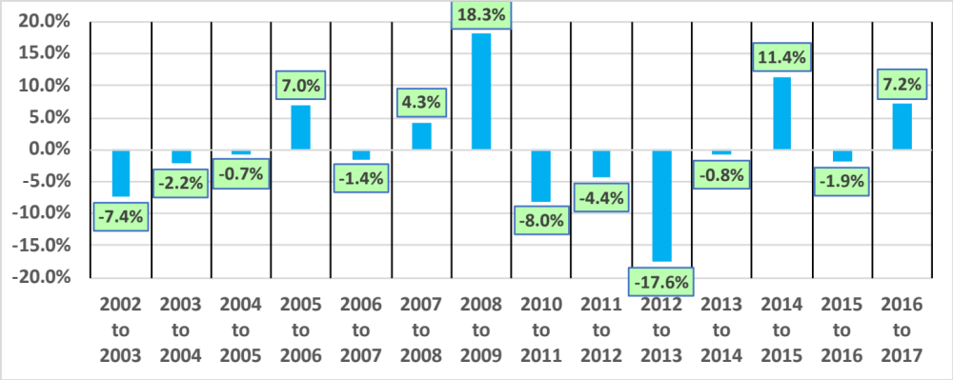
Annual Percentage Change in the Total State Appropriation

Slide 31
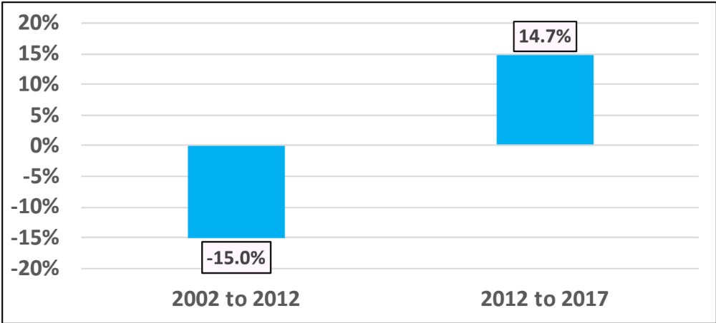
Long-Term Percentage Changes in the State Appropriation

Slide 32
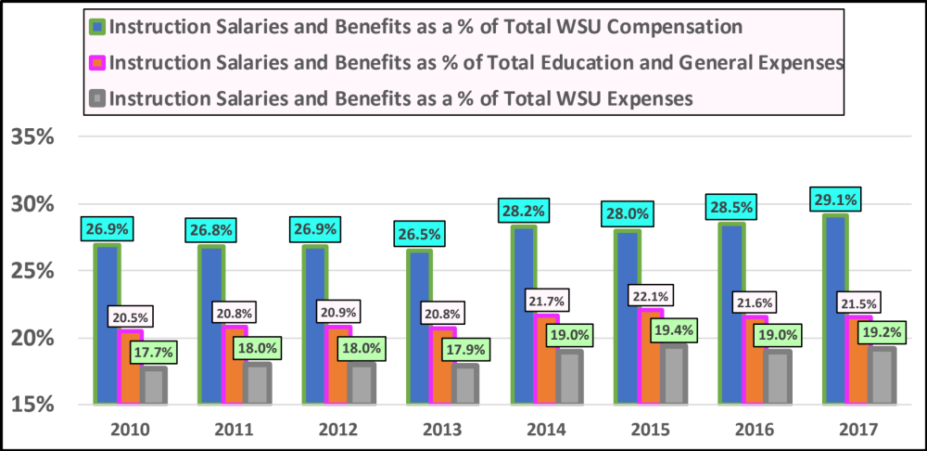
Spending on Instructional Salaries and Benefits (all but medical faculty)
No Changes in the Last Four Years

Slide 33
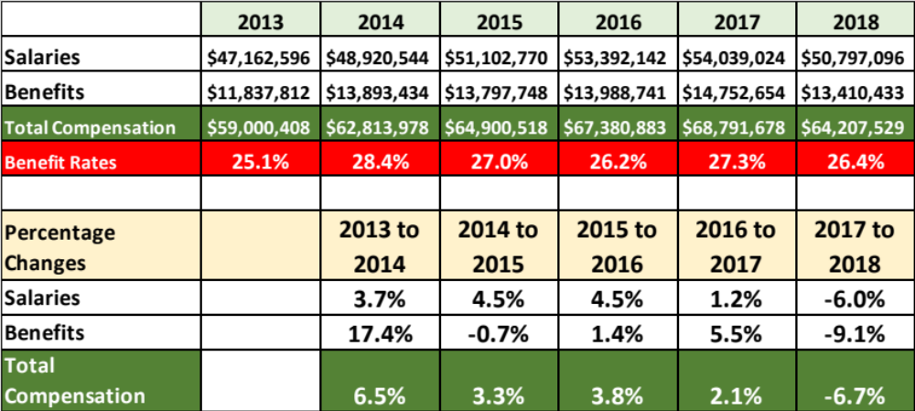
Salaries and Benefits of Bargaining Unit Faculty Only

Slide 34
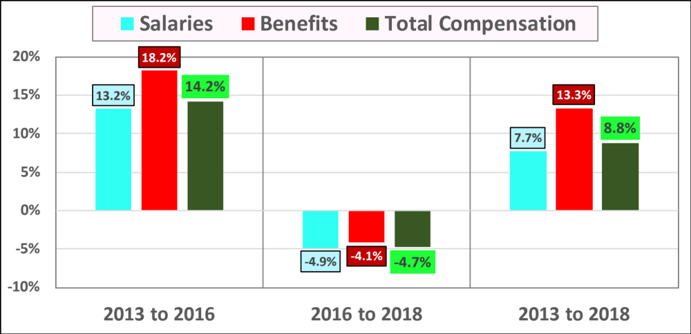
Long Term % Changes in Bargaining Unit Compensation

Slide 35
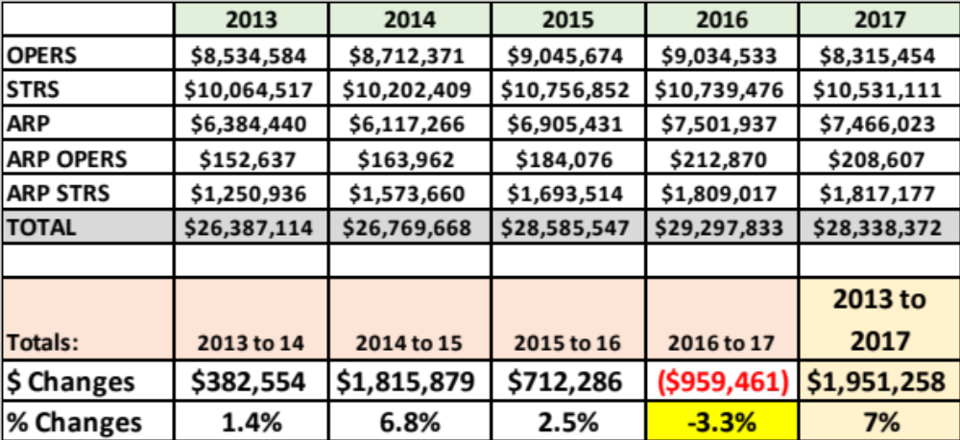
Cash Spent by WSU on Pensions: Decline from 2016 to 2017
Source: Audited Financial Statements

Slide 36
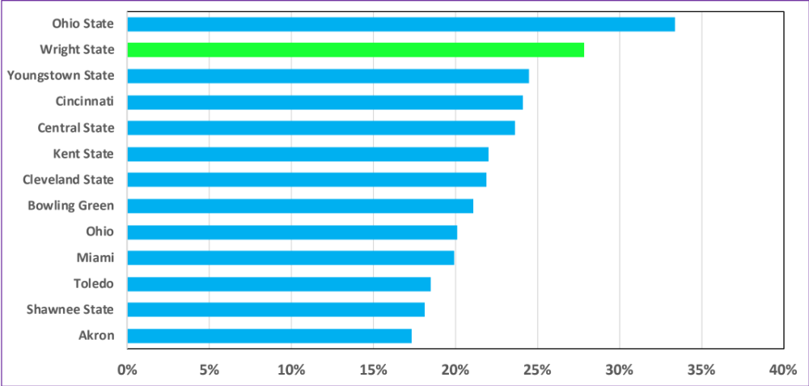
Administrative Salaries as a % of Education & General Spending
Source: https://www.ohiohighered.org/sites/ohiohighered.org/files/uploads/affordability-efficiency/Administrative%20Productivity%20Measure.pdf
WSU | 28%
Ohio Average | 22%
Reduction in Admin spending if WSU spent the Ohio Average | ($15,896,825)

Slide 37
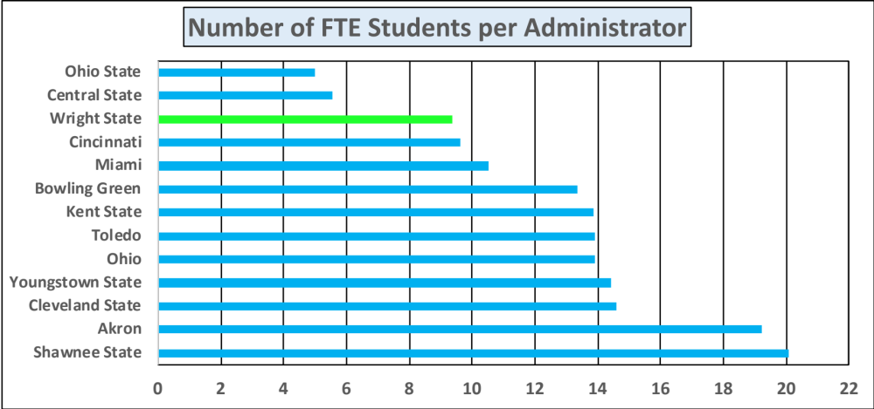
Number of Administrators per Student FTE;
Lower Ratio Means More Admins per Student
Source: Ohio Board of Education
Peer Average | 12.4
# of WSU Admins | 1,215
# of WSU Admins if WSU had average ratio | 920
# of Excess WSU administrators | 295
% of Excess Administrators | 24%

Slide 38
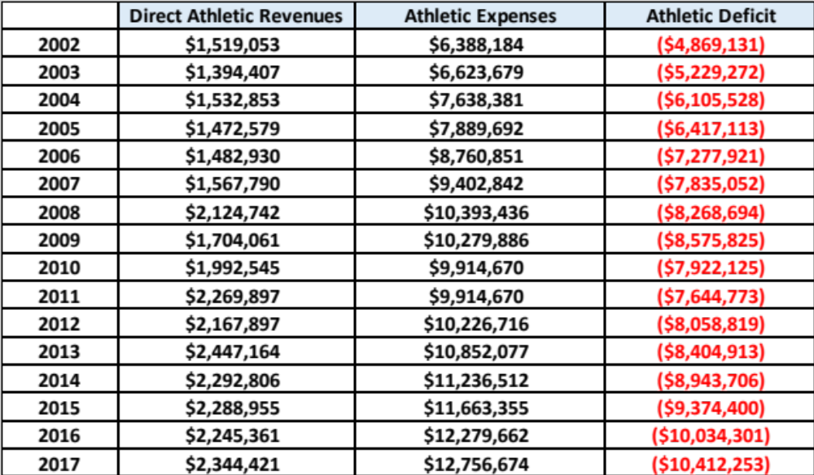
Athletics: Direct Revenues and Expenses
Sources: USA Today Database and NCAA Management Report
From 2013 to 2017:
Revenues down 4%
Expenses up 18%

Slide 39
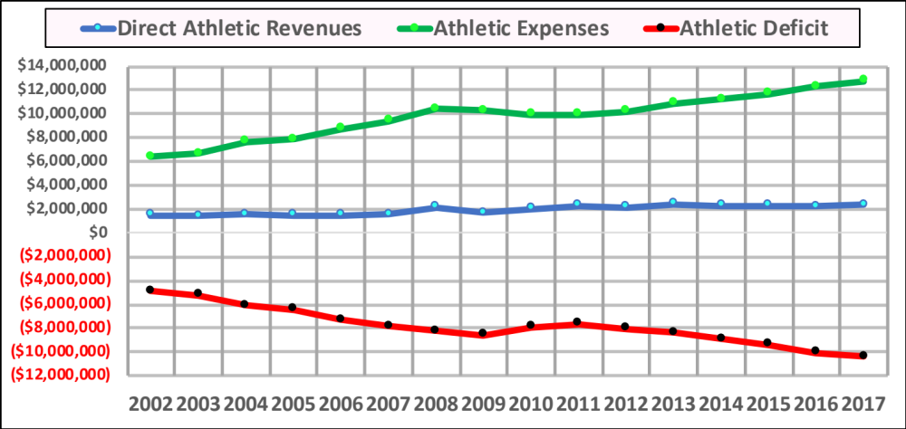
Athletic Revenues and Expenses Graphically

Slide 40
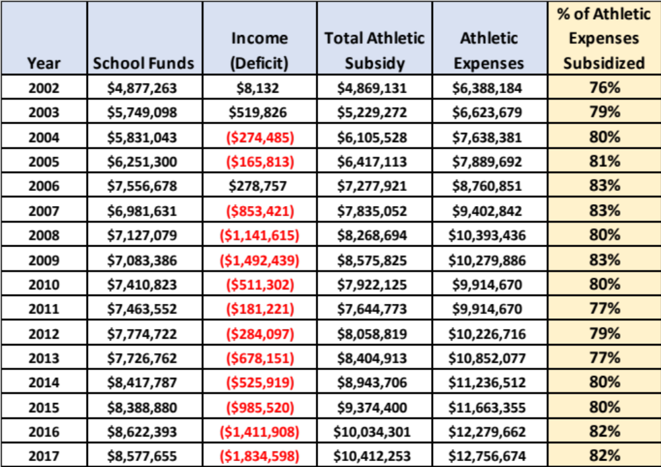
Subsidy in Dollar and Percentage Terms

Slide 41
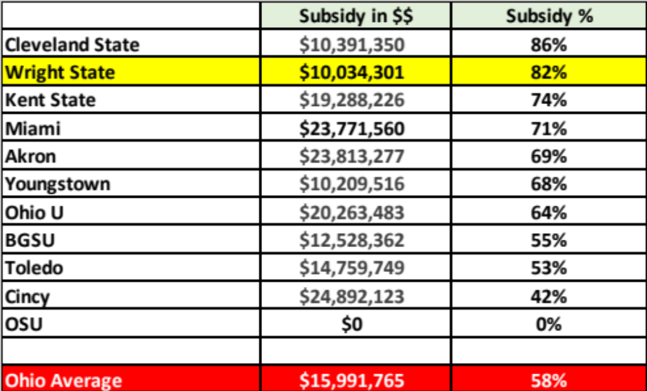
Subsidy of Other Ohio Institutions

Slide 42
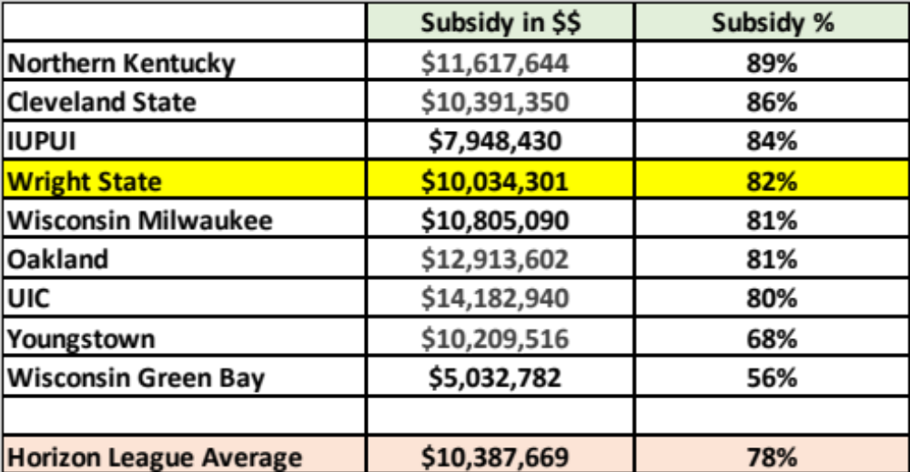
Subsidy of Other Horizon League Institutions

Slide 43
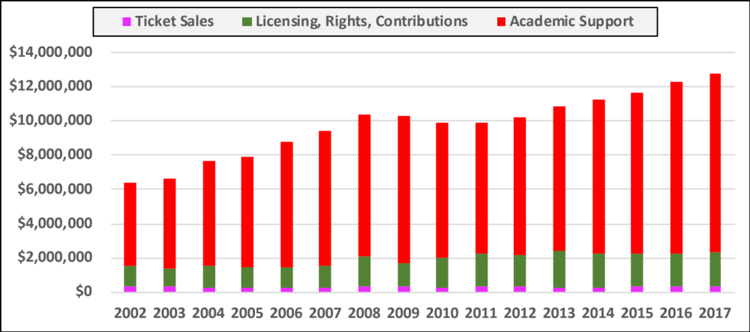
WSU Athletic Revenues and Athletic Subsidy

Slide 44
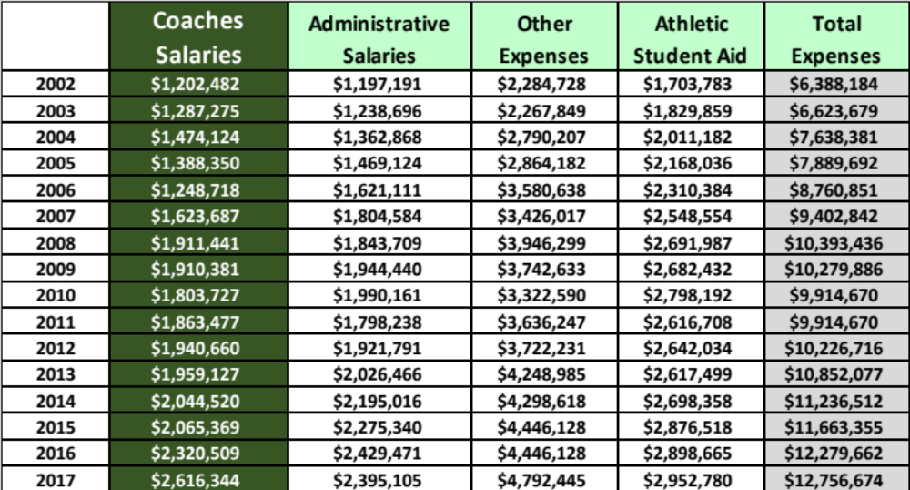
Individual Athletic Expenses

Slide 45
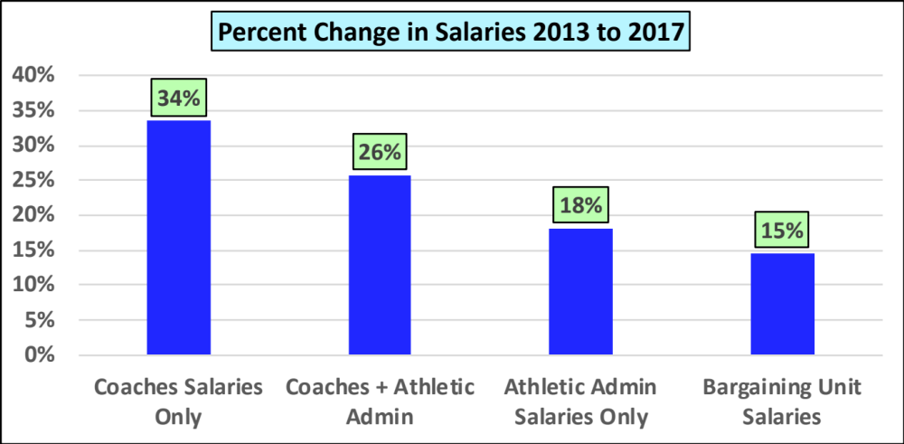
Academics vs. Athletics: Change in Coaches Salaries vs. Academic Salaries

Slide 46
Other Athletic Issues
Source: Wright State Current Funds Budget, Fiscal Year 2018
The athletic department spends over its budget in recent years, which is in addition to the subsidy
For 2018, athletics is budgeted to have a subsidy fro E&G of $10.2 million
The Nutter Center is budgeted to have a subsidy of $875,55. This is an additional subsidy from academics to athletics
In total auxiliaries need $13.8 million of support from academics. Auxiliaries are designed to be self-supporting, but they are not. This is mostly due to the fact that athletics generates very little revenue

Slide 47
5.
Faculty Salaries Under the Administration Proposal

Slide 48
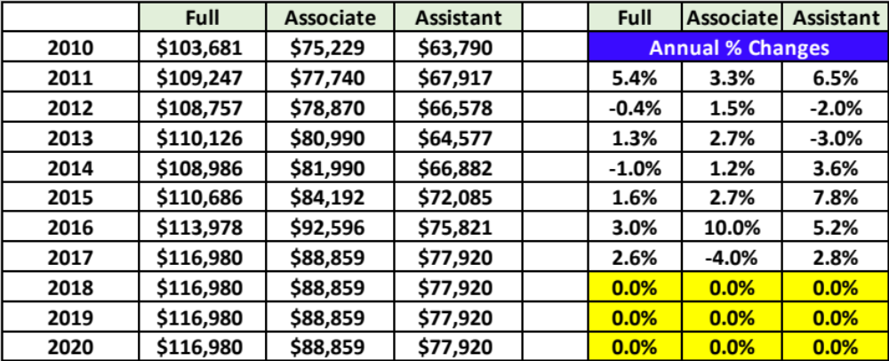
WSU Faculty Salaries and Annual Percentage Changes

Slide 49
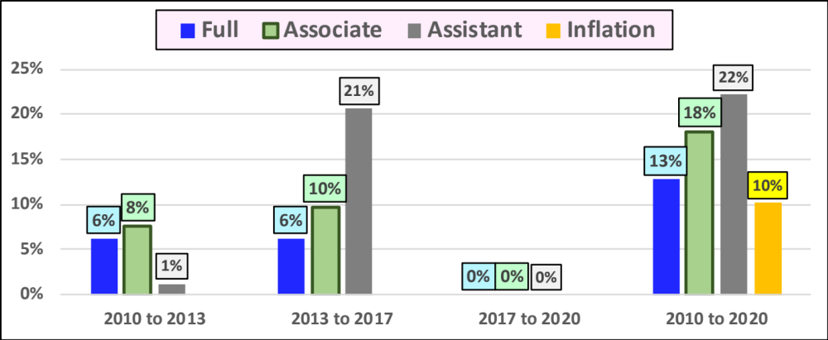
Long-Term Percentage Changes in Faculty Salaries

Slide 50
Average Salary Increases for Ohio Institutions, 2018 to 2020
Source: Collective Bargaining Agreements
 | 2018 | 2019 | 2020
Bowling Green | 3.0% | 3.0% | 2.5%
Cleveland State | 1.0% | 2.0% | 2.5%
Kent State | 2.0% | 2.0% | 2.5%
Miami | 2.5% | 2.5% | 2.5%
Ohio State | 2.5% | 2.5% | 2.5%
Ohio U | 2.5% | 2.5% | 2.5%
Akron | 2.0% | 3.0% | 4.0%
U-Cincinnati | 2.5% | 3.0% | 2.5%
Toledo | 2.0% | 2.5% | 2.5%
Youngstown | 2.5% | 2.5% | 2.5%
Wright State | 0.0% | 0.0% | 0.0%
Ohio Average | 2.3% | 2.6% | 2.7%

Slide 51
Wright State vs. Peers Over Time, Full Professors
Year | WSU | Ohio Average | WSU vs Ohio Average | WSU Rank (out of 11)
2010 | 103,681 | 101,868 | 1,813 | 3
2011 | 109,247 | 101,642 | 7,605 | 2
2012 | 108,757 | 103,946 | 4,811 | 2
2013 | 110,126 | 106,956 | 3,170 | 3
2014 | 108,986 | 106,724 | 2,262 | 5
2015 | 110,686 | 110,686 | 0 | 6
2016 | 113,978 | 112,808 | 1,170 | 5
2017 | 116,980 | 116,980 | 0 | 6
2018 | 116,980 | 117,096 | (115) | 7
2019 | 116,980 | 120,608 | (3,628) | 8
2020 | 116,980 | 124,772 | (7,791) | 10

Slide 52
Wright State vs. Ohio Peers Over Time, Associate Professors
Year | WSU | Ohio Average | WSU vs Ohio Average | WSU Rank (out of 11)
2010 | $75,229 | $73,902 | $1,327 | 3
2011 | $77,740 | $74,594 | $3,146 | 3
2012 | $78,870 | $76,039 | $2,831 | 3
2013 | $80,990 | $80,132 | $858 | 4
2014 | $81,990 | $82,001 | ($11) | 6
2015 | $84,192 | $83,381 | $811 | 4
2016 | $92,596 | $84,211 | $8,385 | 2
2017 | $88,859 | $87,021 | $1,838 | 4
2018 | $88,859 | $88,859 | $0 | 6
2019 | $88,859 | $89,715 | ($856) | 8
2020 | $88,859 | $93,304 | ($4,445) | 9

Slide 53
Wright State vs. Peers Over Time, Assistant Professors
Year | WSU | Ohio Average | WSU vs Ohio Average | WSU Rank (out of 11)
2010 | $63,790 | $60,438 | $3,352 | 4
2011 | $67,917 | $62,429 | $5,488 | 2
2012 | $66,578 | $64,520 | $2,058 | 5
2013 | $64,577 | $67,986 | ($3,409) | 8
2014 | $66,882 | $70,815 | ($3,933) | 8
2015 | $72,085 | $72,070 | $15 | 5
2016 | $75,821 | $73,647 | $2,174 | 4
2017 | $77,920 | $76,093 | $1,827 | 5
2018 | $77,920 | $76,854 | $1,066 | 5
2019 | $77,920 | $78,391 | ($471) | 7
2020 | $77,920 | $80,350 | ($2,431) | 9

Slide 54
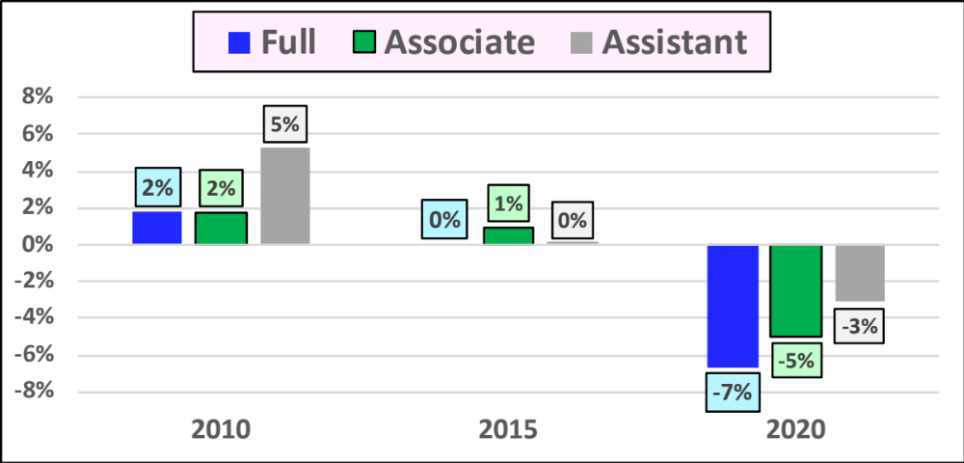
WSU vs. Ohio Peers: Percentage Differences Over Time

Slide 55
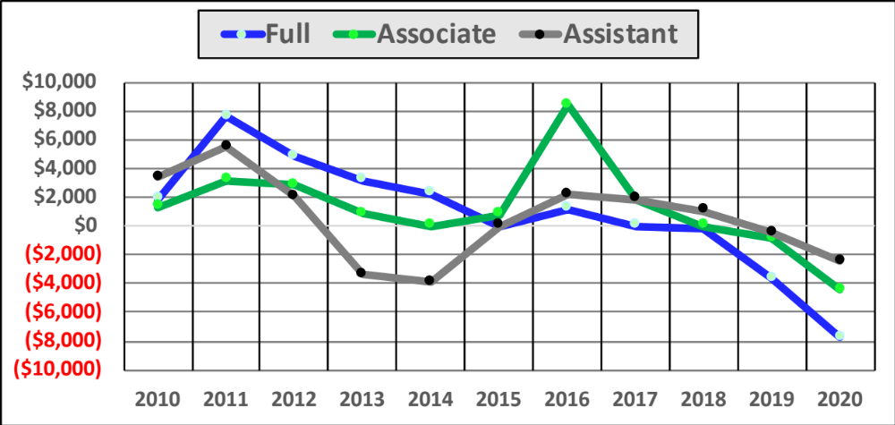
WSU vs. Ohio Peers in Dollars Over Time

Slide 56
6.
Health Care Analysis: Faculty out of pocket costs

Slide 57
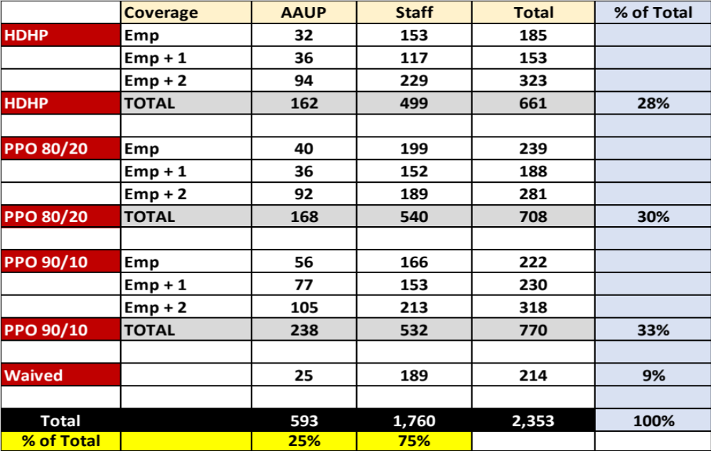
Medical Plan Coverage for All Employees, 2017

Slide 58
Medical Plan Coverage for AAUP by Salary Tiers, 2017
 |  | Salary Tier
 | Coverage | 30k - 49k | 50k - 74k | 75k - 99k | > 100k | Waived | Total | % of Total
 | Emp | 5 | 10 | 11 | 6 |  | 32
 | Emp + 1 | 2 | 17 | 4 | 13 |  | 36
 | Emp + 2 | 11 | 20 | 30 | 33 |  | 94
HDHP | TOTAL | 18 | 47 | 45 | 52 |  | 162 | 27%
 | Emp | 13 | 13 | 9 | 5 |  | 40
 | Emp + 1 | 1 | 15 | 7 | 13 |  | 36
 | Emp + 2 | 12 | 30 | 29 | 21 |  | 92
PPO 80/20 | TOTAL | 26 | 58 | 45 | 39 |  | 168 | 28%
 | Emp | 5 | 28 | 15 | 8 |  | 56
 | Emp + 1 | 3 | 27 | 33 | 14 |  | 77
 | Emp + 2 | 5 | 32 | 44 | 24 |  | 105
PPO 90/10 | TOTAL | 13 | 87 | 92 | 46 |  | 238 | 40%
Waived | Waived |  |  |  |  | 25 | 25 | 4%
 | Total | 57 | 192 | 182 | 137 | 25 | 593 | 100%
 | Percent of Total | 10% | 32% | 31% | 23% | 4% | 100%

Slide 59
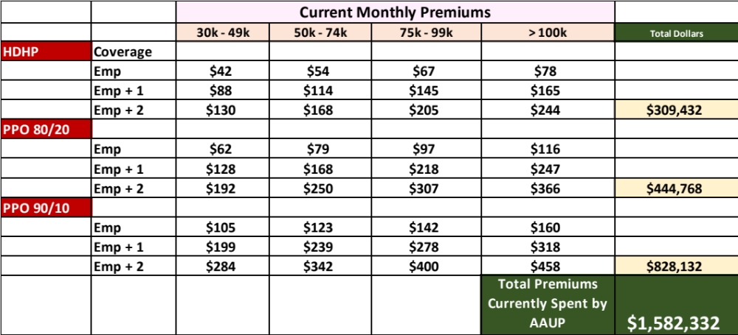
Current Medical Premiums Paid by AAUP Members

Slide 60
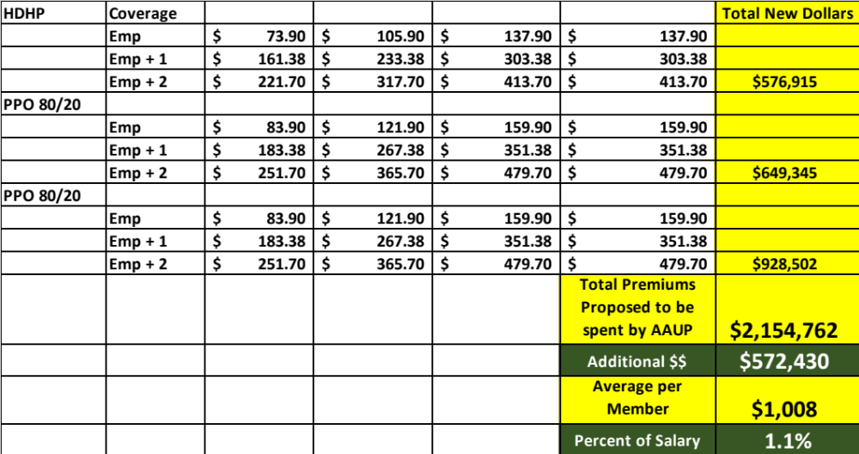
Proposed Total Premiums by WSU Administration

Slide 61
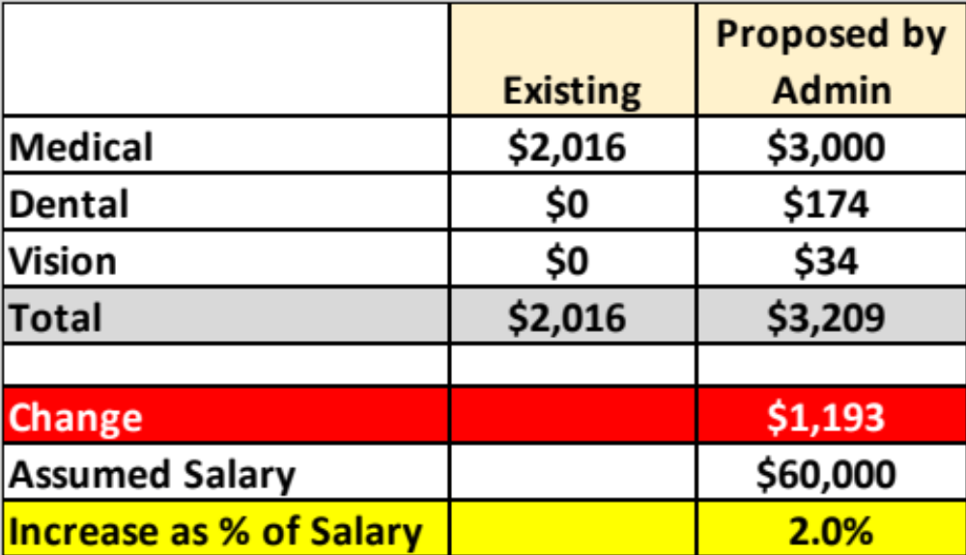
Annual Premiums for PPO 80/20 Plan, Salary 50k to 74k

Slide 62
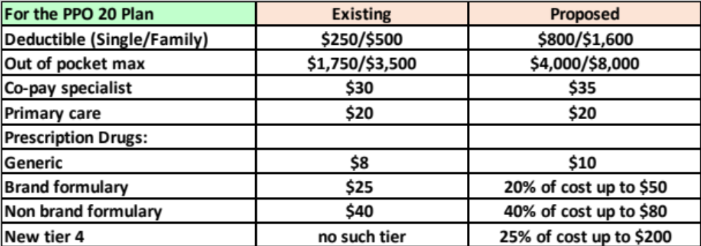
Proposed Administration Changes in Other Aspects of the Health Plans
Source: http://www.wright.edu/sites/www.wright.edu/files/page/attachments/2018staffNBUFplancomparison1.pdf
Also note that the PPO 90/10 will no longer exist; only an 80-20 plan will be offered, which will lead to higher out of pocket costs in the form of co-insurance

Slide 63
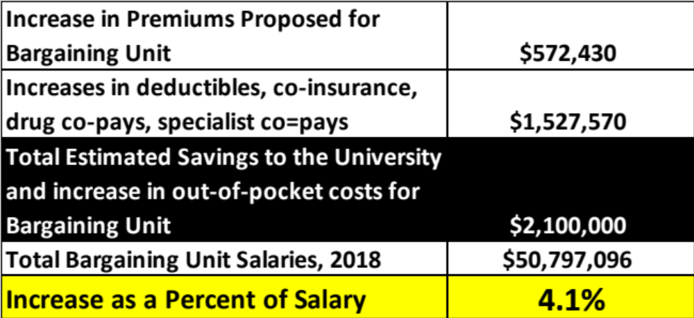
What Could These Changes Mean for the Bargaining Unit?
Source for the $2.1 Million change: Reported by the WSU VP for Business and Operations ad VP Business and Finance at negotiations, December 12, 2017

Slide 64
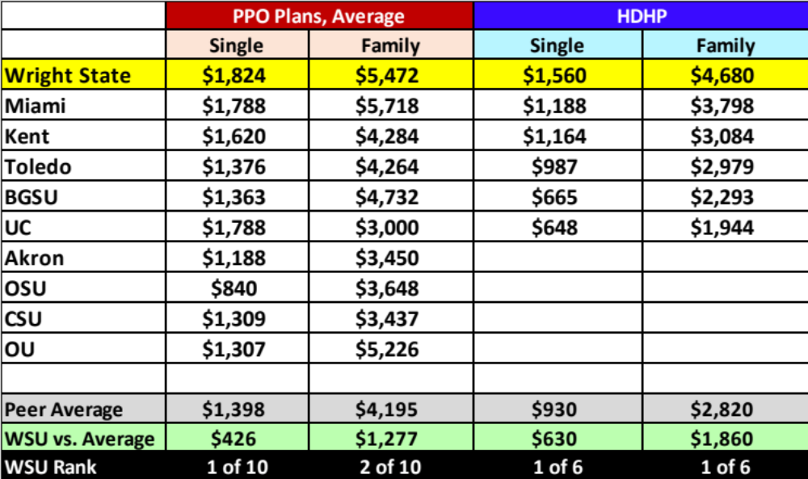
Proposed WSU Annual Premiums vs. Ohio Peer Institutions
Sources: HR Websites of peer institutions; For WSU, amounts are for faculty > $75,000

Slide 65
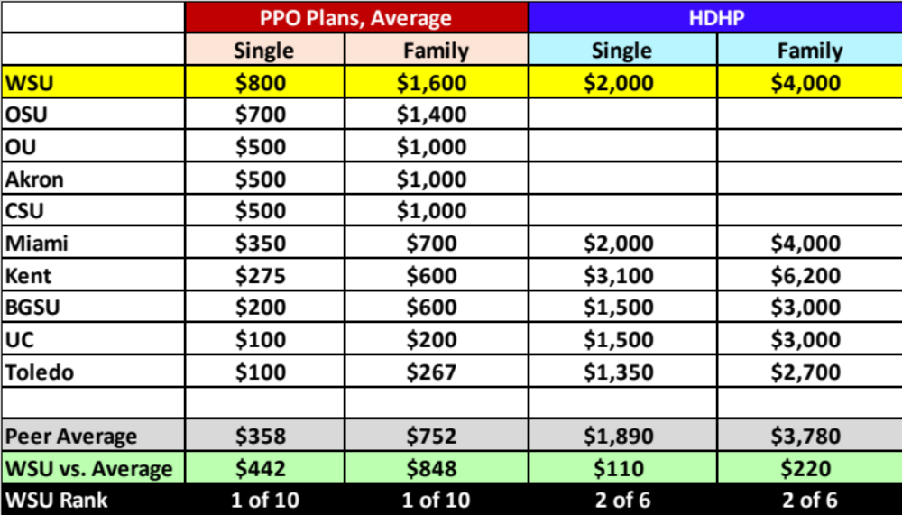
Proposed WSU Deductibles Compared to Other Ohio Institutions:
(Sources: HR websites of peer institutions

Slide 66
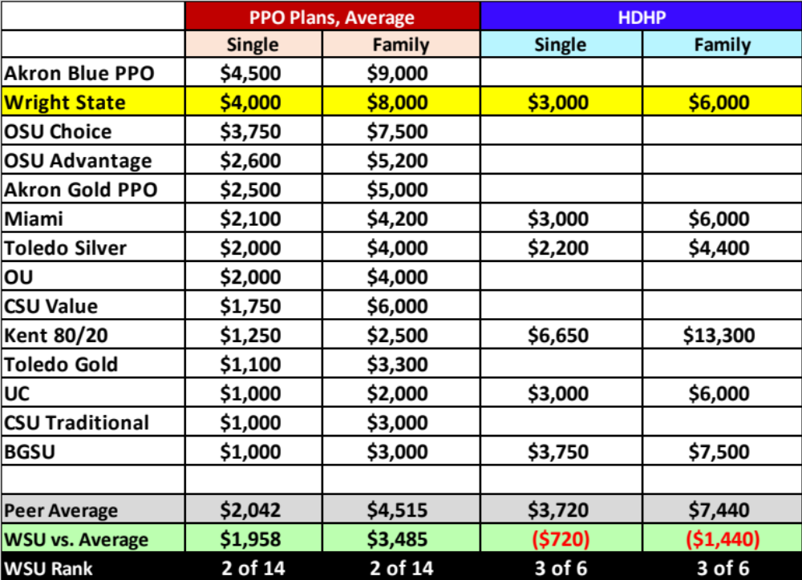
Out of Pocket Maximums, WSU vs. Ohio Peer Institutions

Slide 67
Conclusion of WSU Administration Salary and Health Care Proposals
With the salary and health care changes proposed, the WSU Administration is offering significant pay cuts for the WSU faculty
The WSU Administration is proposing salary changes that will leave WSU faculty either last or next-to-last versus Ohio peer institutions
The WSU Administration is proposing health care changes that will likely lead WSU faculty to have the most onerous health care costs of any Ohio peer institution

